Slide 1


the patterns
cloud native design, domain driven design & microservices
Notes:
Resting slide on screen before you begin presenting.

Slide 2
Agenda
The Monolith
Domain Driven Design
Cloud Native

Slide 3
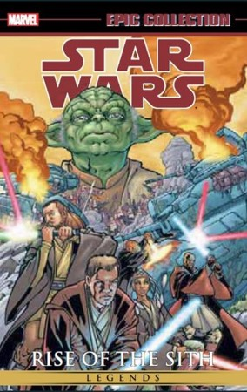
The Monolith
Forces
Solution
Resulting Context
Notes:
Forces
Team of developers working on a project
New team members must be productive
Application must be easy to understand and modify
Scale up - scalability, availability and resiliency
Solution
Multi-module packaged in single WAR or even EAR
Single directory hierarchy
N-Tier Architecture
Layered Architecture
Resulting context
Complexity becomes the enemy
Overloaded web container
Continuous delivery becomes burdensome
Scale out
Technical debt
Domain specificity

Slide 4
“Anyone who has never made a mistake has never tried anything new.”
- Albert Einstein
Notes:
The object here is if you fail then fail fast
What is the methodology for designing a microservice?
How to break up a monolith?
What are the design patterns?

Slide 5
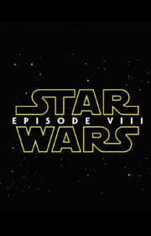
Domain Driven Design
Cloud Native Design
Notes:
Rise of the Jedi is the focus here, design patterns and architecture to move us away from the dark side

Slide 6
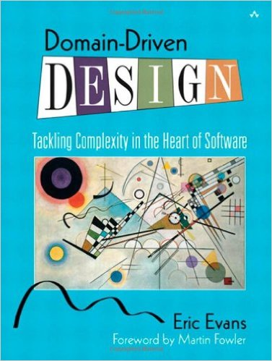
Domain Driven Design
An approach for designing software system that model the complexity of the real world
Kicked off in 2004 by Eric Evans
A practical microservice design methodology

Slide 7
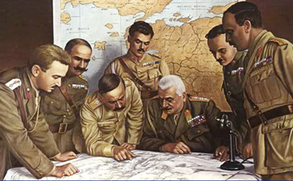
Strategic Domain Driven Design
Domain
Sub-Domain
Bounded Context
Ubiquitous Language
Context Map
Notes:
Picture from http://www.quikmaneuvers.com/principles_of_strategy.html need to check on license rights
Bounded Context - A Bounded Context is the boundary that surrounds a part of a particular domain. This boundary isolates the model and language from other models and therefore helps reducing ambiguity and clarifying the meaning. When the boundaries are chosen well, greater decoupling between systems can be achieved which allows to easily change or replace the internals of a BC. Avoid having transactions across multiple BCs.
Ubiquitous Language - The language that is structured around the domain model is called the Ubiquitous Language. It is important that this language is used by all team members (developers, analysts, business stakeholders, …) to connect all the activities of the team with the software. The vocabulary on its own does not have any relevance, it only has meaning inside a certain context. For example, an Item has a different meaning in the Orders BC than in the Products BC.

Slide 8
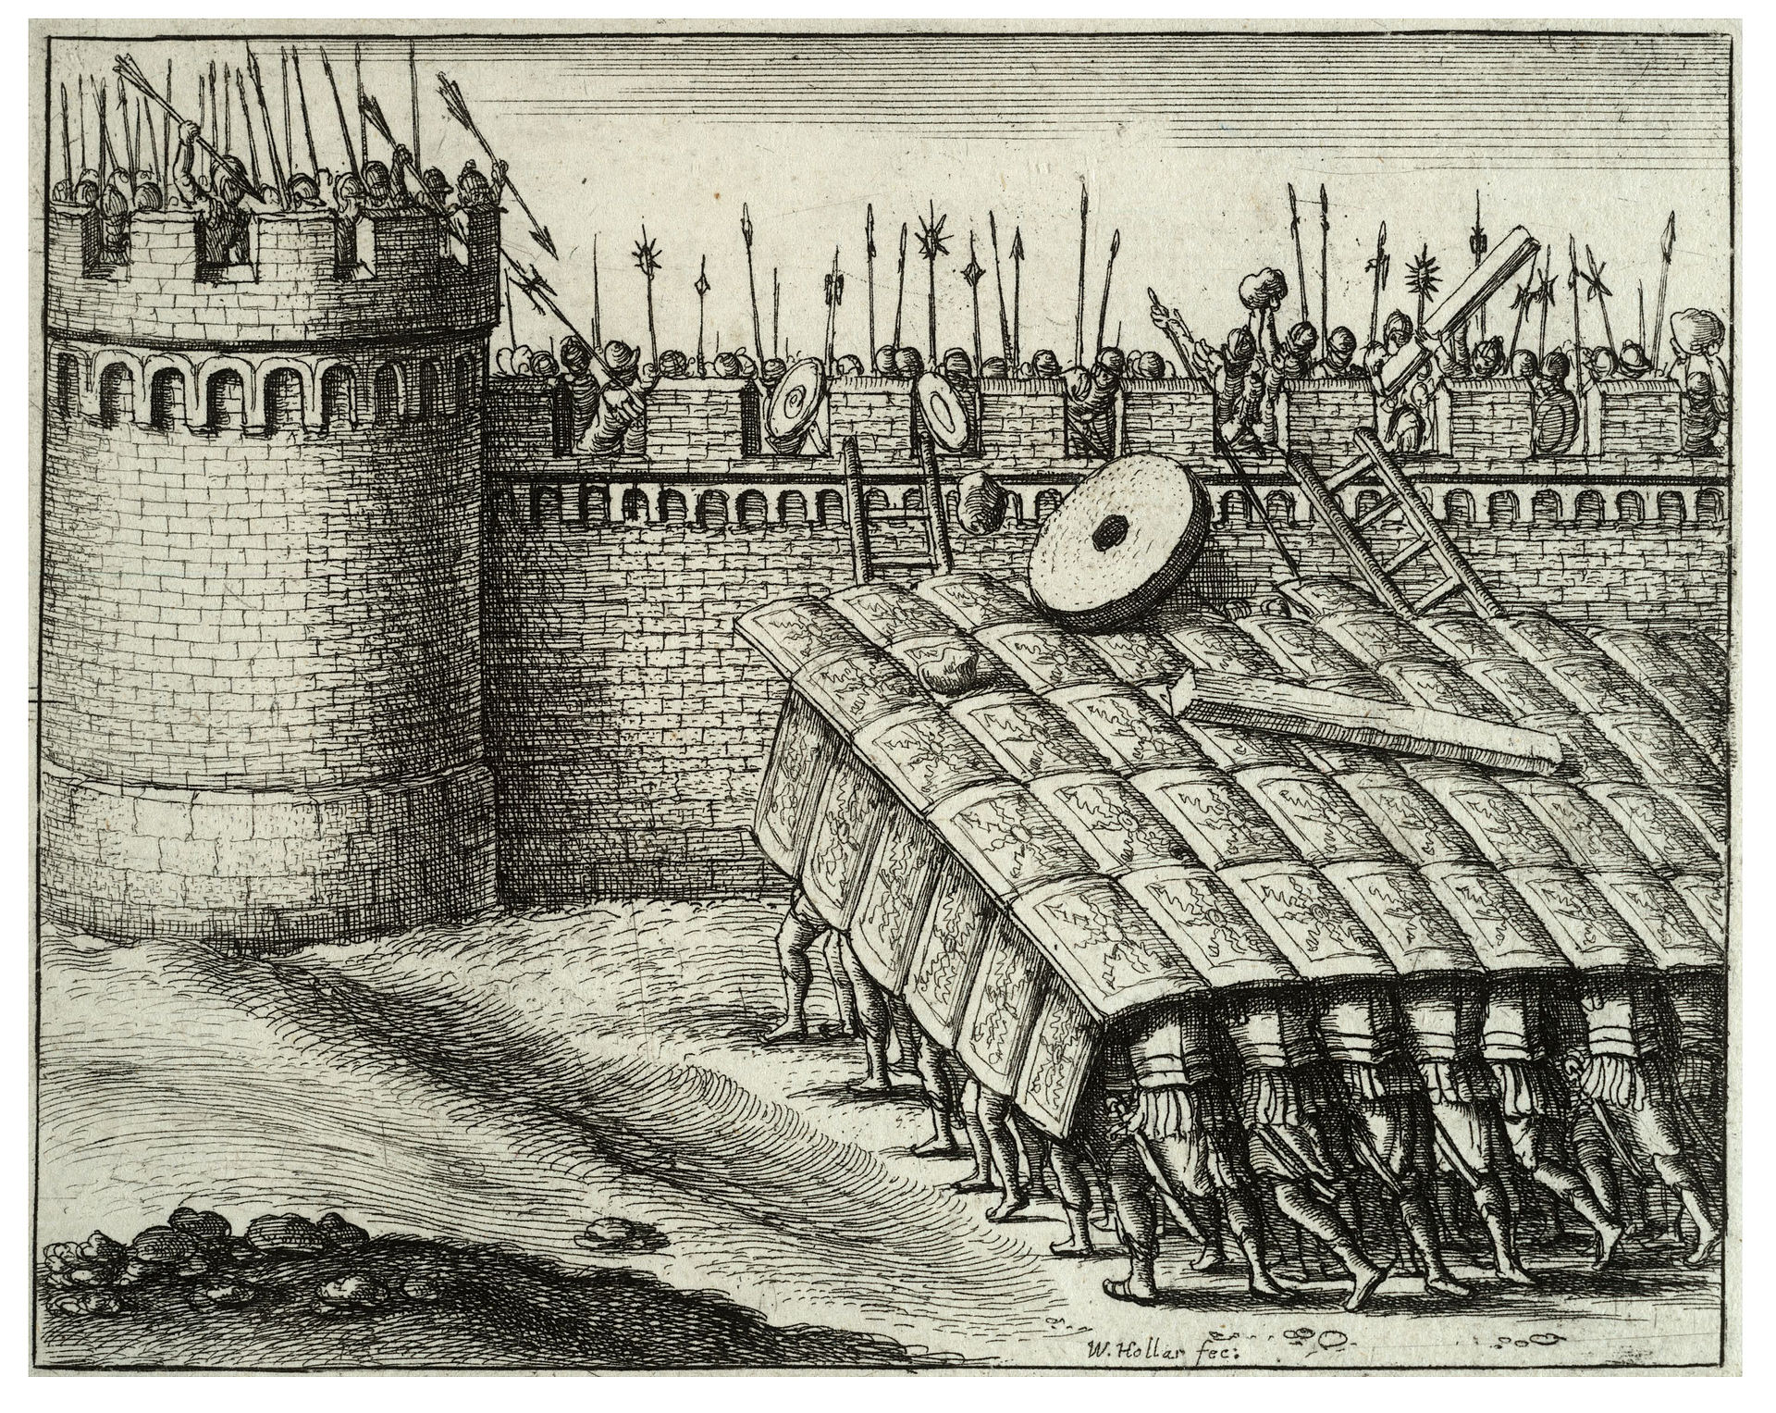
Tactical Domain Driven Design
Entities
Value Objects
Aggregates
Services
Modules
Factories
Repositories
Notes:
Value Objects -- Represent a concept from the domain that — as the name suggests — is considered a value. In terms of classes that means that individual instances don’t have identity, no lifecycle. A value object needs to be immutable to ensure integrity of the instances as they can be shared amongst different consumers. Value objects are usually part of other model elements like entities or services.
Entities -- In comparison to value objects, an entity’s core trait is it’s identity. Two customers named Chris Pratt might not constitute the very same instance, so that usually a dedicated property is introduced to capture the identity. Another core trait of entities is that they’re usually subject to a certain lifecycle within the problem domain. They get created, they undergo certain state changes. Entities usually relate to other entities and contain properties that are value objects or primitives.
Aggregates -- An Aggregate is a cluster of closely related entities that can be treated as a single unit. The common parent of that cluster is called an Aggregate Root. An example can be an Order and its Line Items, these will be separate objects but it is useful to treat the Order (the Aggregate Root) together with its Line Items as a single Aggregate.
Repositories -- A Repository is an abstraction over a persistence store for Aggregates. It acts like a collection by exposing methods to add and remove objects which encapsulate the actual interaction with the underlying data store. It also has elaborate query capabilities which return fully instantiated Aggregates whose attributes values meet the criteria.

Slide 9
The Building Blocks

Slide 10
Domain
Domain is always organization specific
Captures unique know how and way that an organization does business
Composed of sub-domains & bounded contexts

Slide 11
Sub-Domains
Core
Subdomain
Supporting
Subdomain
Generic
Subdomain
Build It Perfectly
Build It
Just enough
Buy It

Slide 12
Bounded Contexts
Notes:
When modeling a domain any attempt to model it as a whole is doomed to fail as the sheer number of stakeholders and their different views on the domain might be very different and trying to craft a single, unique model to satisfy all of the needs might be either completely impossible or the source of great complexity in the best case. Let’s have a look at a sample sketch that outlines identified concepts in a a Point of Sales (POS) domain. As you can see we already grouped the model elements slightly to differentiate from more remote ones. Looking at the core concepts of customer and order here we can still identify different contexts in which the model elements just discovered might play a role in. Here we identified core high-level parts of the system that might all deal with the concept of a customer or an order but are usually interested in different aspects of them. The accounting context is usually interested in billing information of a customer and different payment options while the shipping context’s sole interest is usually shipping addresses and tracking an order. The order context might know about a product through its line items but actually only refers to what is essentially maintained by the catalog. This boils down to model elements which might appear as a singular concept at first glance needing to be reflected in different way in different aspects of the system. Modern software architecture even sometimes takes this a step further and even aligns system boundaries with such a bounded context, actively accepts redundance and eventual consistency to reduce the complexity of the individual systems, fosters resilience and increases development productivity.

Slide 13
Ubiquitous Language
Technical Jargon
Business Jargon

Slide 14
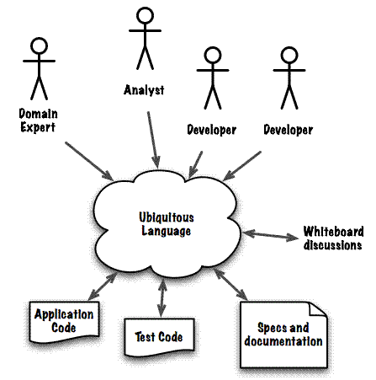
http://www.infoq.com/articles/ddd-contextmapping

Slide 15
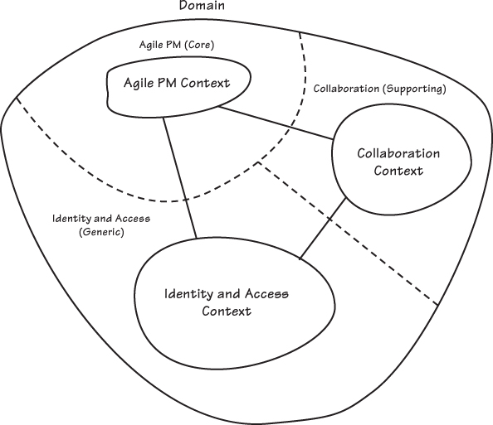
Solution
Figure 2.7 from Implementing Domain Driven Design

Slide 16
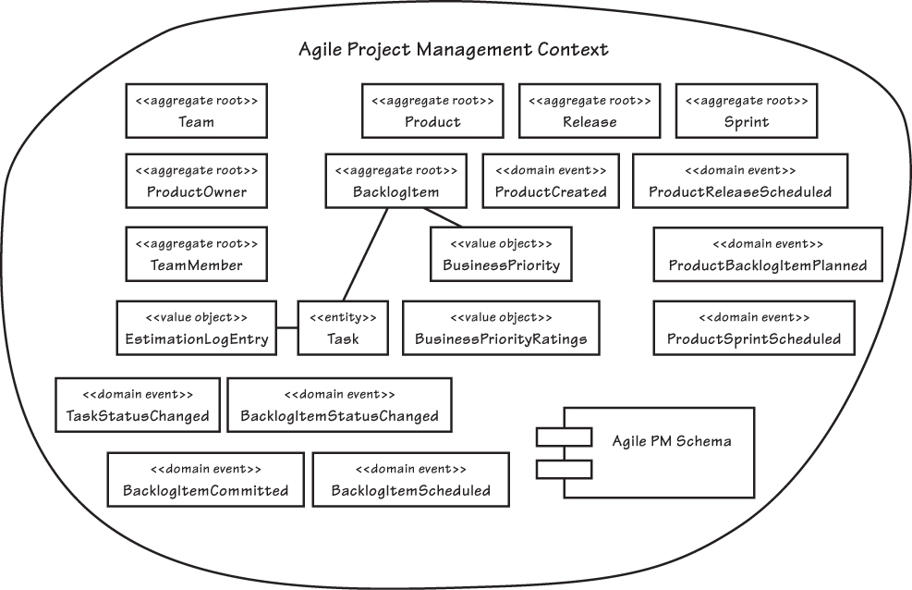
Example Bounded Context
Entities
Domain Event
Value Objects
Aggregates
Services
Modules
Factories
Repositories
Notes:
Figure 2.10 from Implementing Domain Driven Design

Slide 17
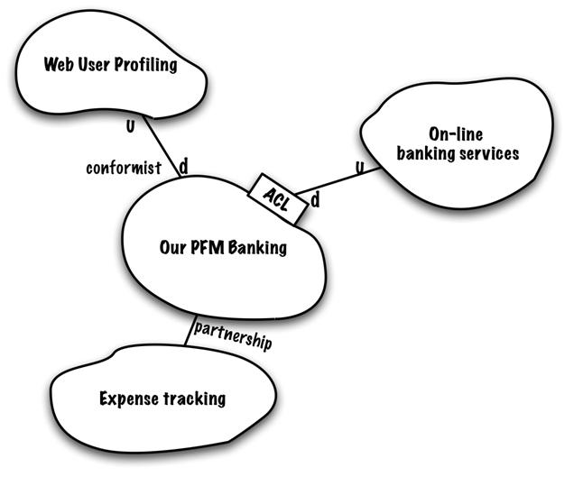
Context Maps
A map of the existing organization & integration relationship between different bounded contexts
Partnership
Shared kernel
Customer-supplier development
Conformist
Anti-corruption layer
Open host service
Published language
Big ball of mud
Notes:
The Bounded Context by itself does not deliver an overview of the system
By introducing a Context Map we describe the contact between models and contexts
The Context Map is also a great starting point for future transformations

Slide 18
Partnership
Succeed or fail together promoting a close co-operation between teams working on the bounded contexts
Context
A
Context
B
partnership

Slide 19
Customer Supplier
Success of the supplier partially depends on the success of the customer
Context
A
Context
B
customer-supplier
D
U
Notes:
A relationship between two teams. The downstream team is considered to be the customer w/ veto rights.

Slide 20
Conformist
Upstream does not care about downstream
Context
A
Context
B
conformist
D
U
Notes:
The downstream team conforms to the model of the upstream team. The is no translation of models and no vetoing. If the upstream model is a mess, it propagates to the downstream model.

Slide 21
Anticorruption Layer
An isolation translation layer allowing downstream to work with upstream using downstream bounded context domain concepts
Context
A
Context
B
ACL
translated
D
U
Notes:
An ACL uis a layer that insolates a client’s model from another system’s model by translation.

Slide 22
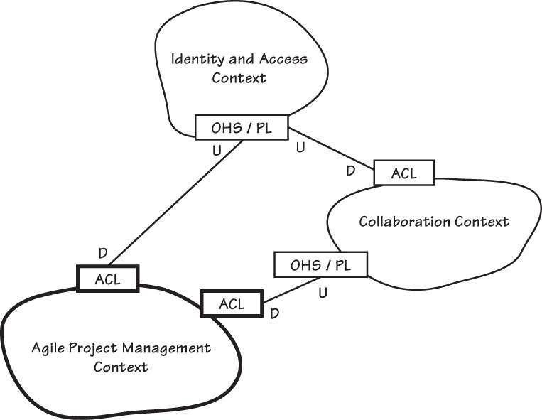
Context Mapping Example
Notes:
Figure 2.10 from Implementing Domain Driven Design

Slide 23
Domain Driven Design
Cloud Native Design
Notes:
Rise of the Jedi is the focus here, design patterns and architecture to move us away from the dark side

Slide 24
Cloud Native Design
Evaluate components for 12-factor compliance
Evaluate components and architecture for Cloud Native Design
Standalone services
Common services
Notes:
The twelve-factor app is a methodology for building software-as-a-service apps that:
Use declarative formats for setup automation, to minimize time and cost for new developers joining the project;
Have a clean contract with the underlying operating system, offering maximum portabilitybetween execution environments;
Are suitable for deployment on modern cloud platforms, obviating the need for servers and systems administration;
Minimize divergence between development and production, enabling continuous deployment for maximum agility;
And can scale up without significant changes to tooling, architecture, or development practices.
Sam Ramji, CEO of the Cloud Foundry Foundation, gave a talk on the meaning of "cloud-native" during the annual Open Source Convention(OSCON), 2015, @see http://www.informationweek.com/cloud/platform-as-a-service/cloud-native-what-it-means-why-it-matters/d/d-id/1321539
Cloud-native applications amount to "prescriptive software stacks" designed to work together for enterprises that are too busy to assemble components themselves

Slide 25
Evaluate for 12-Factor Compliance
no file based access to resources
run code on demand
coordinate cross service configurations
route public requests
read and write persistent data
add and remove resources
record internal and external events
isolate resources and failures
measure performance and health
detect and determine failure (plan & provoke failure)
recover failures
work tomorrow

Slide 26
Evaluate for the Cloud
Cloud Native
Micro-service architecture and principles
API first design
Cloud Resilient
Design for failure
Apps are unaffected by dependent service failure
Cloud Friendly
Twelve factor applications
Horizontally scalable
Cloud Ready
Proactive testing for failure
Cloud agnostic runtime implementation
Metrics and monitoring baked in
Leverage platform for HA
No file-system requirements or uses S3 API
Self-contained application
Platform managed ports and addressing
Consume off platform services using platform semantics

Slide 27
How to start?
Defining your domain, entities that comprise the domain and the necessary domain logic.
Service layer and only add services where the logic doesn't belong in any domain entity or value object.
Use Ubiquitous Language, Design by Contract (DbC), Automated Tests, Continuous Integration / Continuous Delivery and Refactoring
Notes:
Domain driven design effort begins where domain modeling ends. Ramnivas Laddad recommends the following steps on how to go about implementing a domain object model. He emphasizes on putting more focus on domain objects than services in the domain model.
Start with domain entities and domain logic.
Start without a service layer initially and only add services where the logic doesn't belong in any domain entity or value object.
Use Ubiquitous Language, Design by Contract (DbC), Automated Tests, CI and Refactoring to make the implementation as closely aligned as possible with the domain model.

Slide 28
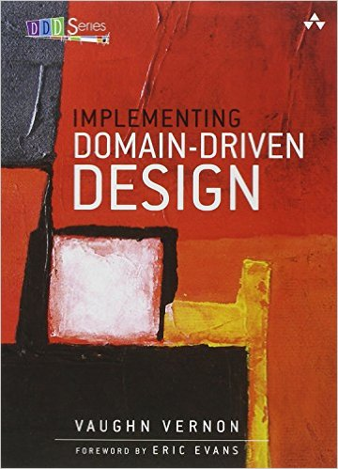
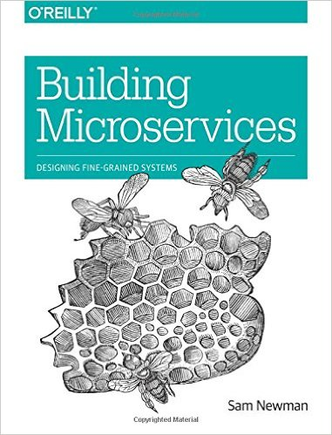
Recommended Reading

Slide 29
Additional Resources
DDD: Strategic Design explained with Spring Boot
DDD and Spring
Bridging the Worlds of DDD and REST
The Twelve-Factor App

Slide 30

Break

